Slide 1
Simulating Self-check-out and cashier lanes using multithreading
Erick P.Wasonga,Daniel Darsamo,scovia Kainza.

Slide 2
Table of contents
02
Idea behind the program
01
Introduction
03
Customer handling capacity
06
Output result
04
Example scenario
05
Code structure and review
06
conclusion
T
0

Slide 3
Introduction
Overview : This presentation covers a program designed to estimate the customer handling capacity in a supermarkert setting.
Purpose: The goal is to determine how many customers can be handled by the cashiers over a given period.
Key components :
Cashier
Customers
Hours of Operation
T
1

Slide 4
The idea behind the program
The program adapts an energy usage estimation formula to the supermarket scenario:
Substitutions:
Processors are replaced by cashiers.
Hours of operation replace hours of runtime.
Energy usage(Watts) is replaced by the number of customers.
Formular: P=(Number of Cashiers)*(Number of Customers)
T
2

Slide 5
Example scenario
Given:
Number of cashier =5
Number of Customers per cashier=12
Hours of operation=10
Calculation:P=5*12*10=600
Interpretation:Over the course of 10hrs ,5 cashiers can handle a total of 600 customers ,assuming each cashier can handle 12 customers per hour.
T
3

Slide 6
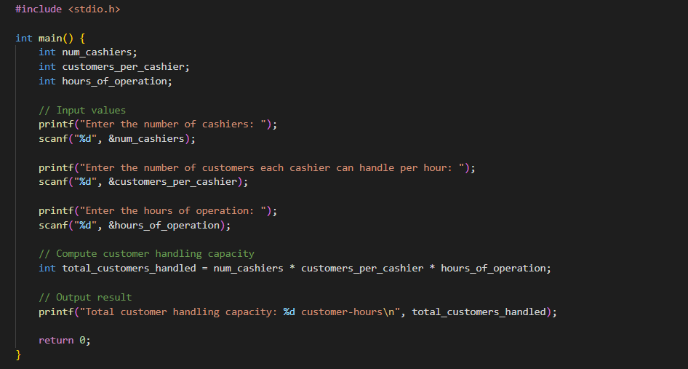
Code structure
T
4

Slide 7
Code structure overview
Variable Declaration:
‘int num_cashiers’: Stores the number of cashiers.
‘int customers_per_cashier ‘: Stores the number of customers each cashier can handle.
‘int hours_of _operations: Stores the hours of operations.
Input Value:Prompts for the number of cashier,customers per cashier and hours of operation.
Compute customer Handling capacity: Formular application.
Output result: Displays total customer handling capacity.
Return statement: ‘main’ function returns 0.
T
5

Slide 8
Input values
Input Values
The program promts the user to enter :
Number of cashiers.
Number of customers each cashier can handle per hour .
Hours of operation
T
6

Slide 9
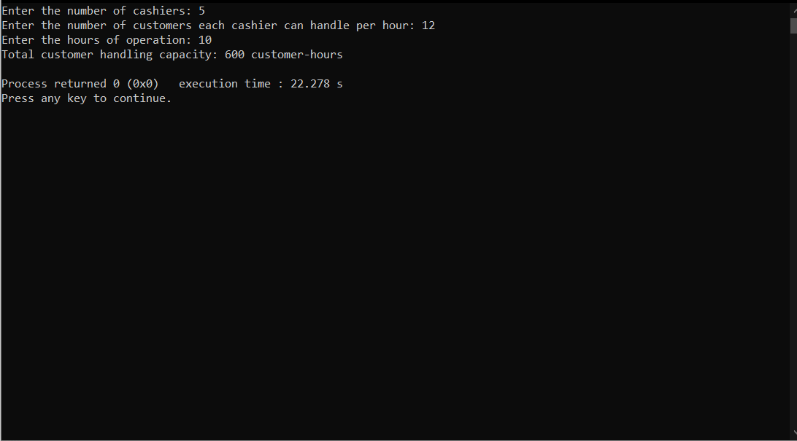
Output result
The program outputs the total customer handling capacity using ‘printf’. The ‘main’ function returns 0 to indicate successful completion of the program
T
7

Slide 10
Conclusion
Summary: This program helps estimate how many customers can be handled by cashiers in a given period based on the number of cashiers ,their handling capacity ,and hours of operation.
Imporatnce: Accurate estimation of customer handling capacity s crucial for efficient supermarket operations.
Potential Extensions: The program can be extended to handle more complex scenraios ,such as varying customer arrival rates and different cahier speed.
T
8

